Slide 2
Practical Pros & Cons of Replacing Swing with JavaFX in Existing Applications
Notes:
In this presentation, you’ll be focusing on new features in NetBeans IDE, while also providing a context for those of your audience who are not familiar with NetBeans IDE.

Slide 3
JavaFX provides a rich client API as a new and exciting way to develop client user interfaces. What are its key strengths and weaknesses? Is it ready to be used in production to replace Swing? This panel discussion addresses the relevance of JavaFX in the context of existing Swing applications. It demonstrates and analyzes applications created in farm management, logistics, mission operations, and artificial intelligence. The panelists show how their applications based on the NetBeans application framework leverage JavaFX, and they share their experiences of replacing Swing with JavaFX and porting Swing components to JavaFX.
Notes:
In this presentation, you’ll be focusing on new features in NetBeans IDE, while also providing a context for those of your audience who are not familiar with NetBeans IDE.

Slide 4

Fair Questions to Ask
Readiness
Is JavaFX ready to be used, at all?
What does “ready” mean? “Ready for toy applications” is not “Ready”, for example.
If JavaFX is ready, what are the risks for using it? Can its readiness be reverted?
How to mitigate the risks, how to keep all options open, how to adopt carefully.
Relevance
If it is ready and risks can be mitigated, what is its place in existing Swing applications?
Does it have a place, at all?
What are the actually useful features that JavaFX provides, versus all the hype and buzz, etc?
Replacement
Which parts of JavaFX to use and the strategies for doing so
Replace all of Swing with JavaFX? Swap out Swing during upgrades?
Don’t reinvent the wheel if others have walked the road already

Slide 5
Sean Phillips
Timon Veenstra
Rob Terpilowski
Commonalities:
Large applications, heavy investment
Based on NetBeans Platform application framework
Tomorrow 16:30 - 17:30: CON4171 Hitchhiker’s Guide to the NetBeans Platform (Hilton - Continental Ballroom 6)

Slide 6
GEONS Ground Support System
Java 7, JavaFX and the
NetBeans Platform supporting
NASA Missions Operations

Slide 7
Java for NASA Mission Support
The GEONS Ground Support System (GGSS) is an independent software tool designed to support analysis and mission operations using NASA GEONS.
The GGSS uses the NetBeans Platform as the basis of the ground system software and will support a 2014 launch of the Magnetospheric Multiscale mission (MMS).
The GGSS is currently deployed in the MMS Mission Operations Control room at the Goddard Space Flight Center (GSFC) now for iterative acceptance testing.
The NetBeans Platform and the latest version of Java 7 has met all the base Mission Requirements for the GGSS.
JavaFX support for charting has been added to the original design as a means of rapid data exploration by both operators and analysts.

Slide 8
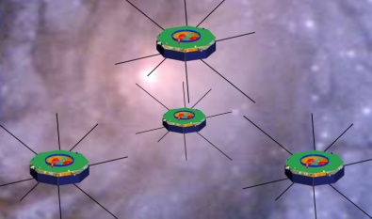
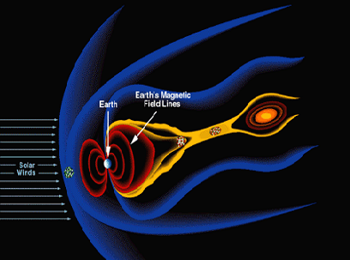
MMS Mission Overview
Earth
Solar
Wind
Sample regions of Scientific Interest at Dayside Magnetopause and the Nightside Neutral Sheet
for a 24 month mission lifetime.

Slide 9
Mission Planning Complexity
12 Planned Apogee raising burns
Tetrahedron Formation
Close Approach avoidance
Maneuvers occur in partial shadow
Sun
Orbits trace shown in Inertial Frame

Slide 10

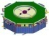
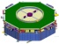
Orbit in the Life
Region of Interest
Real-time
GEONS
Telemetry
Maneuver #2
Orbit Only
GPS Rx OFF
Maneuver # 2 Planning
Maneuver #2
Perigee Raise Only
Apogee
Perigee
DSN Dumps
Of GEONS
Telemetry
Desired Tetrahedron
Maneuver #1
Orb/Att/Spin
50 hr GPS outage

Slide 11
Data Product Generation using NetBeans Platform
NetBeans Platform naturally well suited to fundamental need of all ground system software which is data product generation and management.
Plugin architecture makes integrating core GEONS-related functions easy
Platform is “easily” extendable for other missions flying GEONS
GGSS should be able to be ported outside of the FDOA (e.g. to the FDF) for support on other missions with minimum impact (e.g. platform independent with clean interfaces to integrate with external packages such as propagators, telemetry extraction, and product formatting utilities)
Routine operations can be automated (e.g. initiated via command line or script)
Highly desirable that GGSS not require costly non-portable licenses

Slide 12
Quick Data Exploration using JavaFX
JavaFX charting capabilities have enhanced the original design of the GGSS.
The GGSS can now provide easy and rapid chart views of different data vectors an a large variety of combinations.
JavaFX facilitated this by reducing the development time (and therefore cost) of the following points:
Easy Drag-And-Drop Event Handling
Easy Custom Serialized DataFormat and Clipboard support
Simplified Concurrency for GUI Rendering
The Combination of the NetBeans Platform custom File Type and the Swing Interop pattern made adding this JavaFX charting view straight forward.

Slide 13
Pros vs Cons on Adding JavaFX to Swing Applications
Should you add JavaFX to your Java GUI???
Pros
Highly reactive GUI components are simpler to develop
Reduced development time for rich GUI components
Reduced code footprint for new components reduces maintenance costs
Cons
Bidirectional Event monitoring between Swing and JavaFX is still a pain.
JavaFX and Heavyweight controls still do not play nice.
Making JavaFX components reusable for Swing and pure JavaFX not so easy
Most of what JavaFX offers is viable via combination of Swing and 3rd party libraries.

Slide 14
Suggestions for JavaFX Adoption
As a "Swing guy" I have really come to appreciate how easy Drag/Drop, Animation and GUI event handling in general is now in JavaFX.
Implementing the interactive Drag and Drop chart controls was FUN!
However JavaFX upgrades to Java are mostly extra nice to haves. To really sell the next generation of developers and convince the current generation to switch how about the following:
More and better 3D rendering support
Fix and Improve support for Heavyweight components for improved backward compatibility
Keep driving toward features that produce a measurable reduction in development time. You can’t argue with the bottom line!

Slide 15
Appendix of Links
Goddard Space Flight Center Portal
http://www.nasa.gov/centers/goddard/home/index.html#.Ufh0KW2f2HM
GEONS Technical Site
http://techtransfer.gsfc.nasa.gov/ft_tech_geons.shtm
MMS Mission Site
http://mms.gsfc.nasa.gov/
ai Solutions, Inc
http://www.ai-solutions.com/

Slide 16


Slide 17
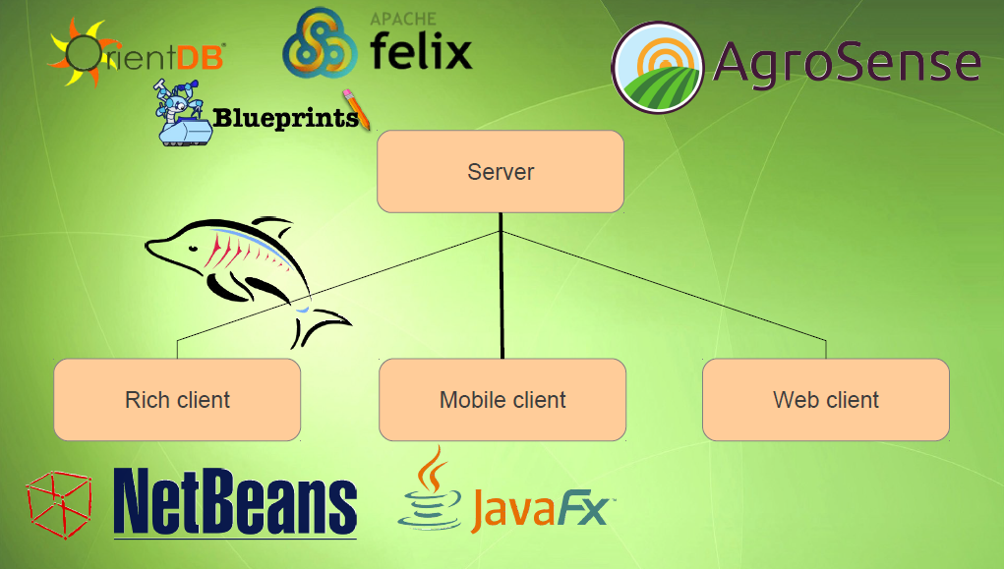

Slide 18
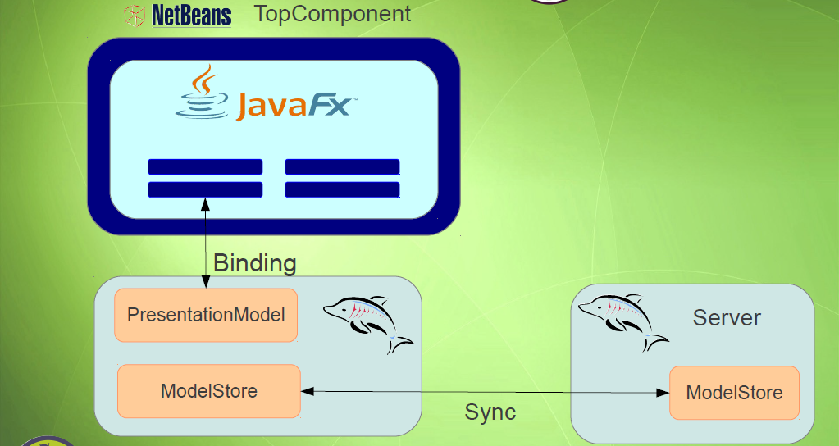

Slide 19
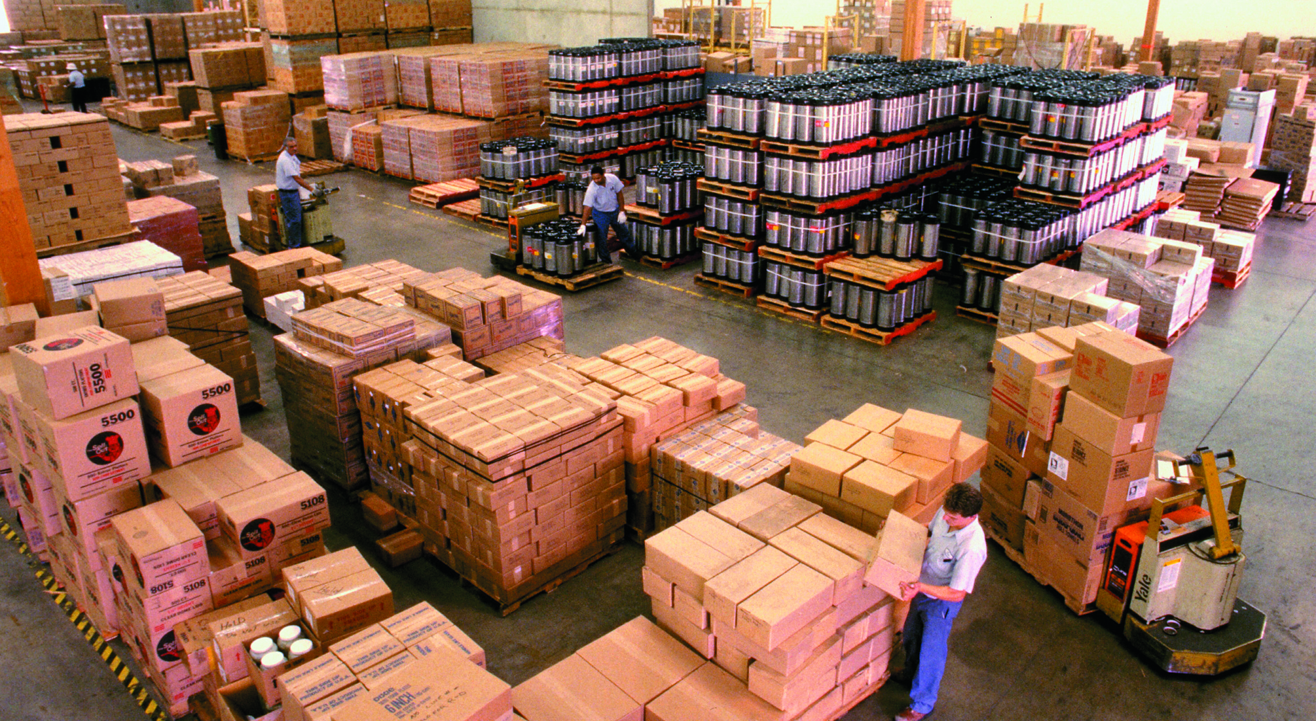

Freight Management with JavaFX on the NetBeans Rich Client Platform
Rob Terpilowski
Lynden, Inc.

Slide 20
About Me
Application Architect at Lynden, Inc.
Technical lead for our freight planning and management application, “FMS”.
Notes:
About Me / Lynden
Application Architect. Technical lead for our freight planning and management application, named FMS.

Slide 21


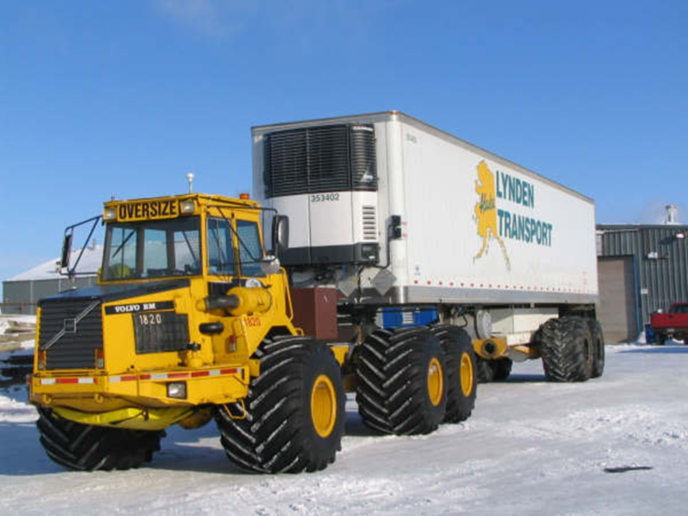
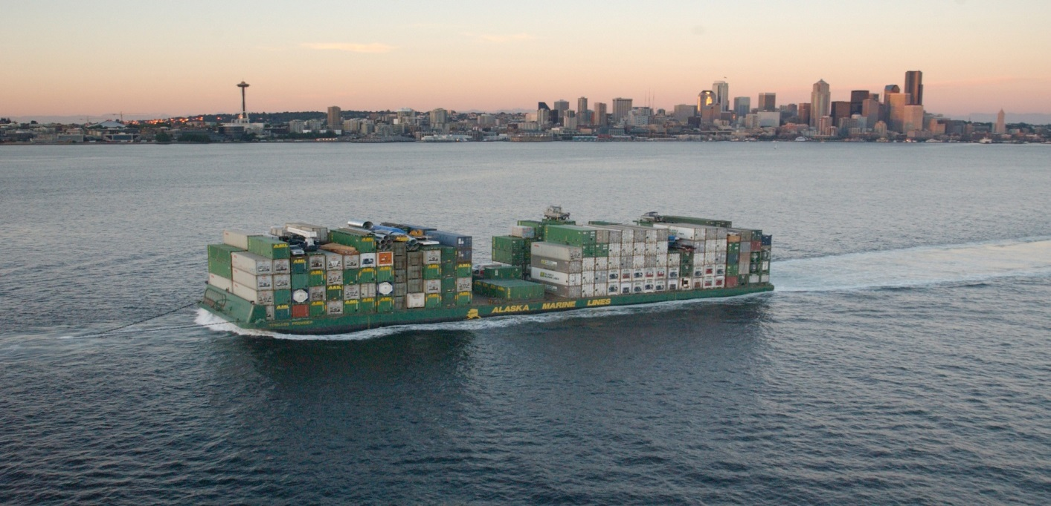
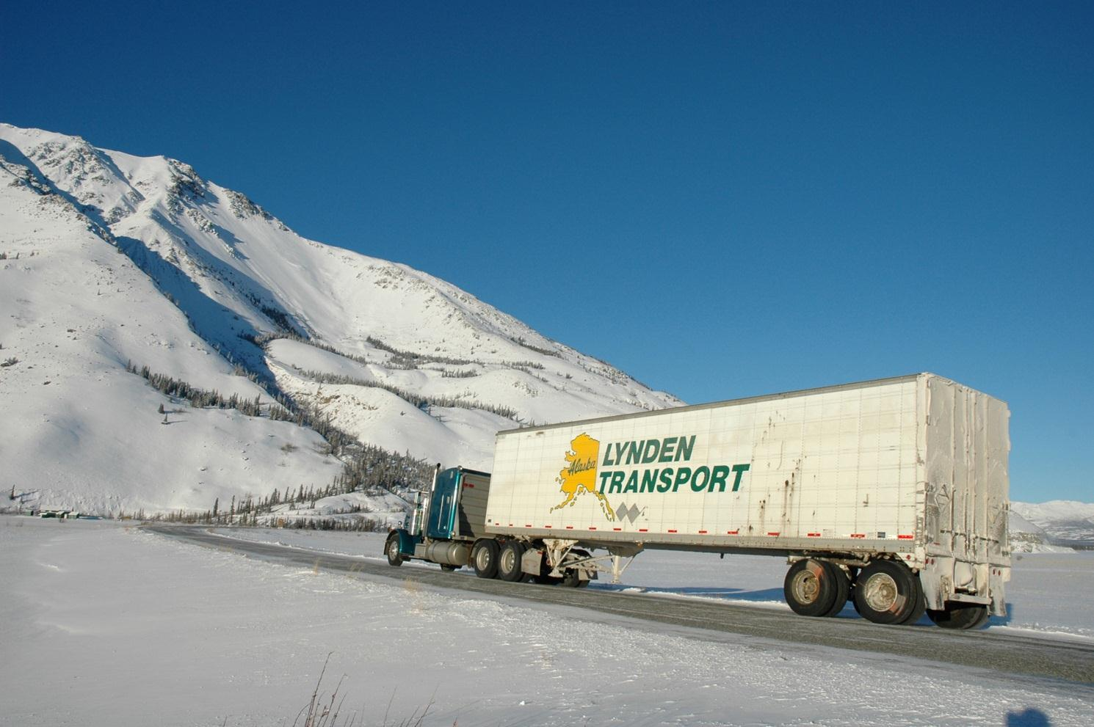

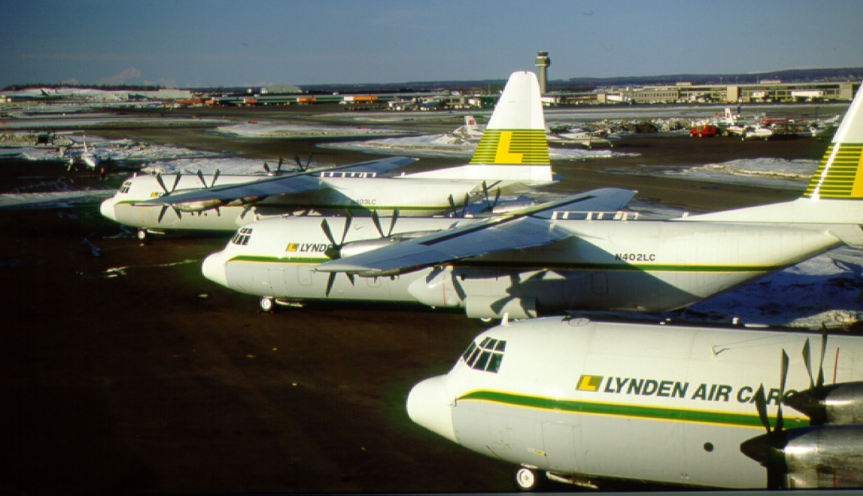






Operating Companies
Notes:
Lynden
Based in Seattle, multi-modal freight and logistics company specializing in shipping to/from Alaska.
Lynden, Inc. parent company owns more than 50 different operating companies, mostly in the Alaskan market, but some companies ship worldwide.
Warehouse terminals across the world and want to give our warehouse managers the ability to plan for the arrival and delivery of freight.
The currently use things such as white boards with scrap paper and magnets, and a bit more modern spreadsheets.

Slide 22

The Problem
Where’s my freight???
Notes:
Trying to answer a seemingly simple question….
Help warehouse managers plan for freight arrival and departure so that they can manage and optimize resources including personal and equipment. Ability to track the current location of a customer’s shipment.

Slide 23
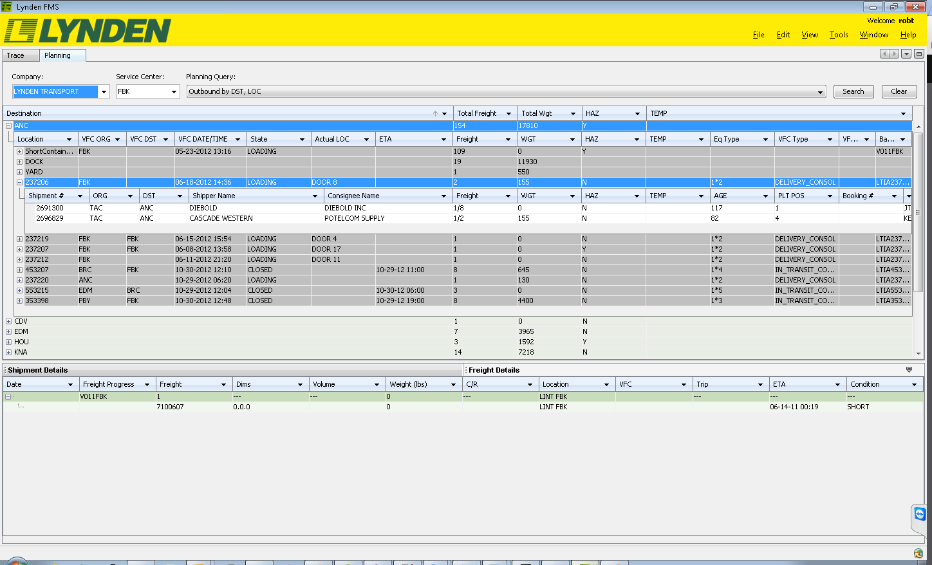
Freight Management RCP App with Swing
Notes:
We set out to build a Freight Management Application (FMS). Based on the netbeans rich client platform. Currently with 2 main modules. “Trace” which will be used by customer service personel and “Planning” which will be used by our warehouse managers for planning for inbound and outbound freight.
We are currently using Netbeans RCP with Swing components including commercial components from JideSoft such as a nested tree table.
Main problem from the users was the amount of data displayed on the screen was overwhelming and difficult to track and navigate.
The next release of the Planning module will contain additional features for planning inbound freight. We wanted to take this as an opportunity to streamline the UI.
JavaFX seemed to be the logical choice since Oracle seems to be throwing its weight behind it as the next generation UI toolkit.

Slide 24
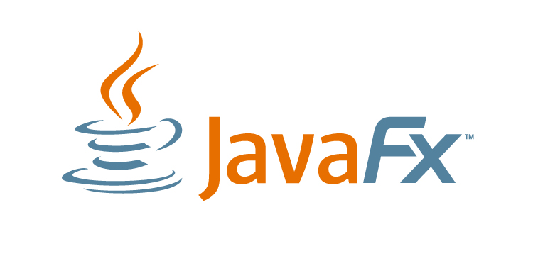
Extreme Makeovers
Notes:
Started with designing some potential screens to enhance the inbound freight planning process.
Using SceneBuilder, FXML, and CSS, some concept screens were created and tweaked.
Netbeans 7 support for JavaFX allows you to open FXML files either in the default text editor or in the Scene Builder WYSIWYG designer.

Slide 25
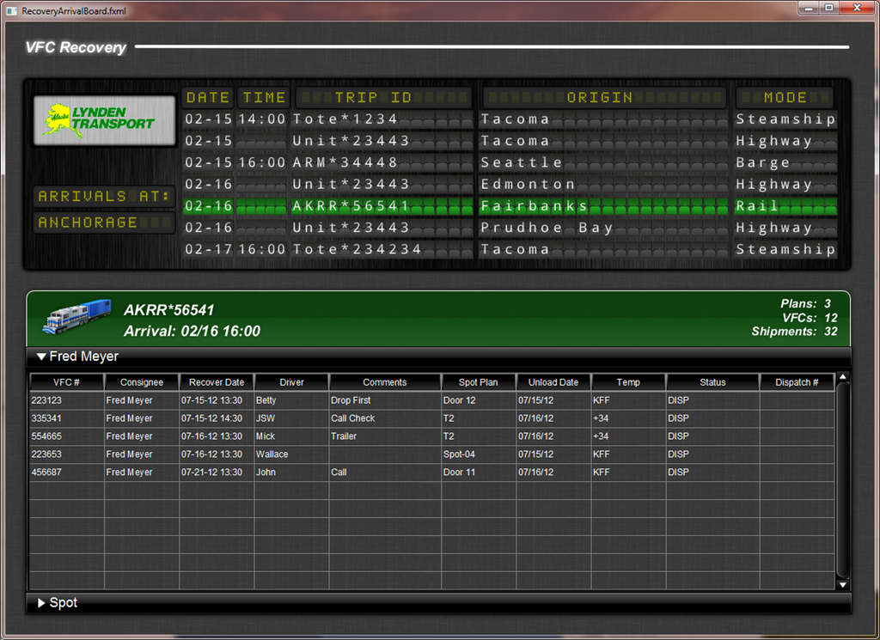
Notes:
Quite a bit different UI concept. Able to create a screen that resembles an airport or train arrival board. Used components from the JFXtras open source UI library.
Designed partially in Java and partially in Java and partially in FXML with SceneBuilder in addition to CSS.

Slide 26
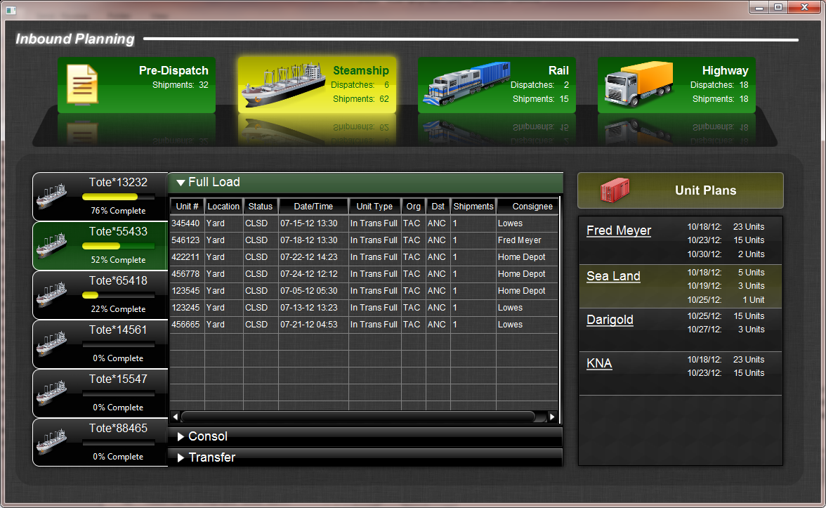
Notes:
Next iteration:
Different modes, ship, rail, highway, selectable tabs at top of UI.
Effects such as reflections, gradients, glow, translucency, which were possible to do in Swing, but a major pain in the ass, are baked into JavaFX.
Fan of eye candy, but can’t justify to management the increase in hours to make an application as polished as this with swing, whereas with JavaFX these effects are standard and can be styled with CSS.

Slide 27
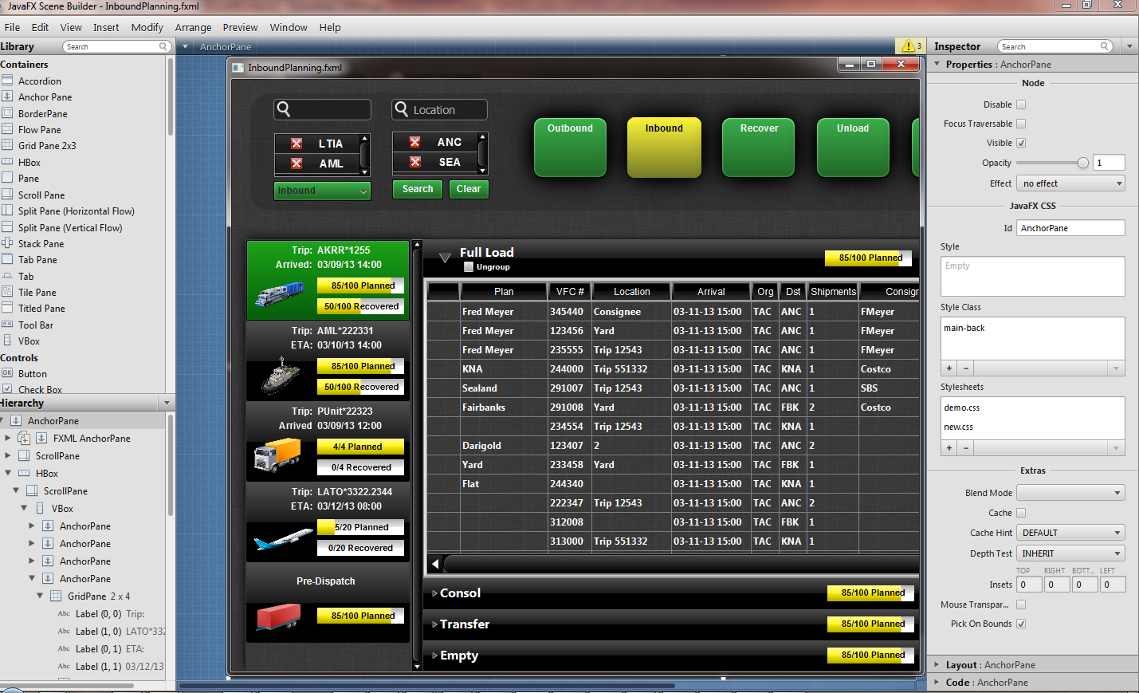
JavaFX UI Design with Scene Builder
Notes:
Scene Builder
WYSYWG

Slide 28
Adding JavaFX to the Swing UI
public FXPlanningTopComponent() {
initComponents();
setName(Bundle.CTL_FXPlanningTopComponentTopComponent());
setToolTipText(Bundle.HINT_FXPlanningTopComponentTopComponent());
Platform.setImplicitExit(false);
Platform.runLater(new Runnable() {
public void run() {
Parent root;
try {
root = FXMLLoader.load(
getClass().getResource("/com/lynden/planning/ui/InboundPlanning.fxml"));
JFXPanel jfxPanel = new JFXPanel();
jfxPanel.setScene(new Scene(root));
} catch (IOException ex) {
Exceptions.printStackTrace(ex);
}
}
});
setLayout(new BorderLayout());
add(jfxPanel, BorderLayout.CENTER);
}

Slide 29
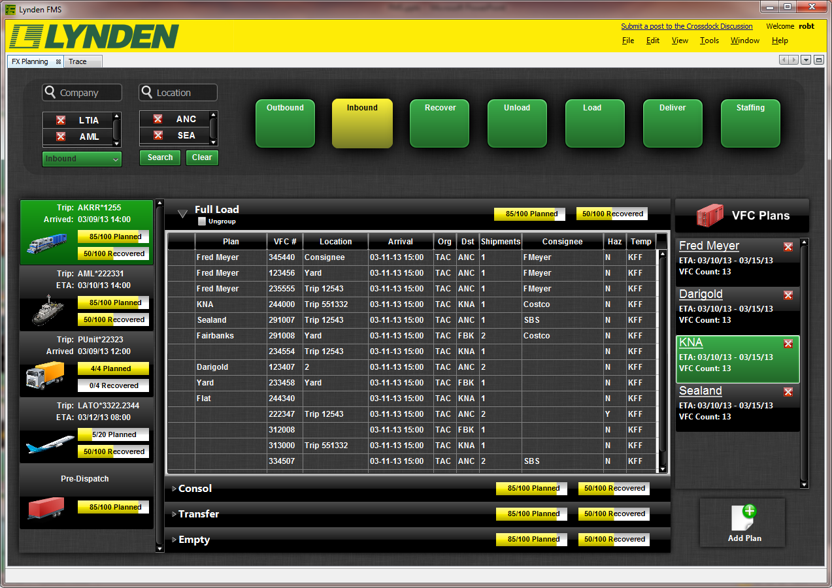
JavaFX in a NetBeans RCP App

Slide 30
Contact Info
Rob Terpilowski
Email: robt@Lynden.com
Twitter: @RobTerp
Blog: http://rterp.wordpress.com

Slide 31
Questions?

Slide 32
Sean Phillips
sean.mi.phillips@gmail.com
@SeanMiPhillips
Timon Veenstra
timon@agrosense.eu
@TimonVeenstra
Rob Terpilowski
robt@Lynden.com
@RobTerp
Geertjan Wielenga
geertjan.wielenga@oracle.com
@geertjanw
Commonalities:
Tomorrow 16:30 - 17:30: CON4171 Hitchhiker’s Guide to the NetBeans Platform (Hilton - Continental Ballroom 6)

